Slide 1


Slide 2

2017 Survey
78% of workers surveyed say that they are living paycheck to paycheck
71% of all workers say they are in some sort of debt
56% of those in debt believe they will never get themselves out of debt

Slide 3


SPENDING
EARNING

Slide 4
Personal Finance
All of the decisions an individual or a family makes in regards to money, including earning, spending, saving, investing and giving.
DEBT
SAVING 10%
GIVING 10%
Financial Literacy
The Little Book of Common Sense Investing
One Up on Wall Street
A Random Walk Down Wall Street
The Intelligent Investor
The Only Investment Guide You Will Ever Need
The Essays of Warren Buffett
The Bible
Financial Literacy
The Millionaire Next Door
Rich Dad Poor Dad
The Richest Man in Babylon
Think and Grow Rich
The Millionaire Fastlane
The Total Money Makeover
Secrets of the Millionaire Mind
Your Money or Your Life
The Science of Getting Rich
The Money Book of the Young, Fabulous & Broke
The Bible
RETIREMENT
BUDGET
INVESTING 10%
EARNING
$ INDEPENDENCE
CAREER
SPENDING

Slide 5
Stepping into the Box
Financial Responsibility and Personal Decision Making

Slide 6


Your Financial Blueprint
What have you heard or read about money?
Who is the saver in your family? Who is the spender in your family? Who are you more like?
Can you remember a time when your family was very financially stressed?
Can you remember a time when someone in your family gave money or bought something for someone in need?

Slide 7

Begin with the End in Mind: Goal Setting
Types of Goals
Personal
Financial
Short-Term Goals- within the year
Intermediate Goals- between 1-5 years
Long-Term Goals- 5 years or more

Slide 8
Begin with the End in Mind: Goal Setting
Be SMART
Specific
Measurable
Attainable
Realistic
Time Bound

Slide 9
Begin with the End in Mind: Goal Setting
Factors That May Influence Financial Goals
Family Responsibilities
Individual Values
Economic Conditions

Slide 10
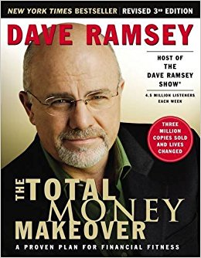
Begin with the End in Mind: Baby Steps
Save $1000 cash as a starter emergency fund
Start the debt snowball
Finish the 3-6 month emergency fund
Invest 15% of your income in retirement
Save for college
Pay off your home mortgage
Build wealth

Slide 11
Begin with the End in Mind:
Five Foundations of Personal Finance
$500 Emergency Fund
Get out of debt
Pay cash for your car
Pay cash for your college
Build wealth

Slide 12
Give 10%
Save 10%
Invest 10%
Spend the rest

Slide 13

“Too many people spend money they earned…to buy things they don’t want…to impress people that they don’t like.”
Will Rogers

Slide 14

Decision Making
People make decisions by weighing the costs and benefits.
opportunity cost- the highest-valued alternative that you give up when you make a decision.
The consequences of your decisions will not be known until sometime in the future.

Slide 15



The Surprising Secrets of America’s Wealthy
1. They live well below their means.
    Average American buyer = $21,000 for new vehicle (Average Millionaire = $24,800)
    50% millionaires surveyed never spent more than $29,000 (20% never spent more than $19,950)
    37% millionaires bought used
    Average = $320,000
    Half have been in the home more than 20 years
3. They believe that financial independence is more important than displaying high social status.

Slide 16

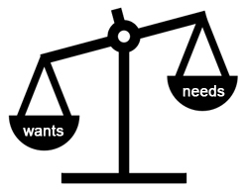

Needs vs. Wants
need- something that is needed in order to survive
  Air
  Water
  Food
  Shelter
  Clothing
want- something you would like to have or desire
near-essential need- something that is not needed for survival but is necessary to live in today’s society

Slide 17





Tom Shadyac- Director/Producer

Slide 18

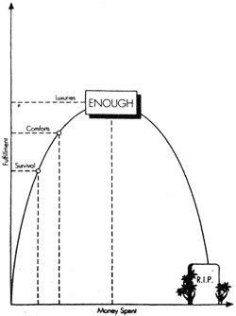
The Fulfillment Curve

Slide 19
Life Rating Scale
Monthly Income | $0-$1500 | $1501-$3000 | $3001-$4500 | $4501-$6000 | Over $6000
Average of quality of life rating for all participants in that income range | 2.81 | 2.77 | 2.84 | 2.86 | 2.63

Slide 20
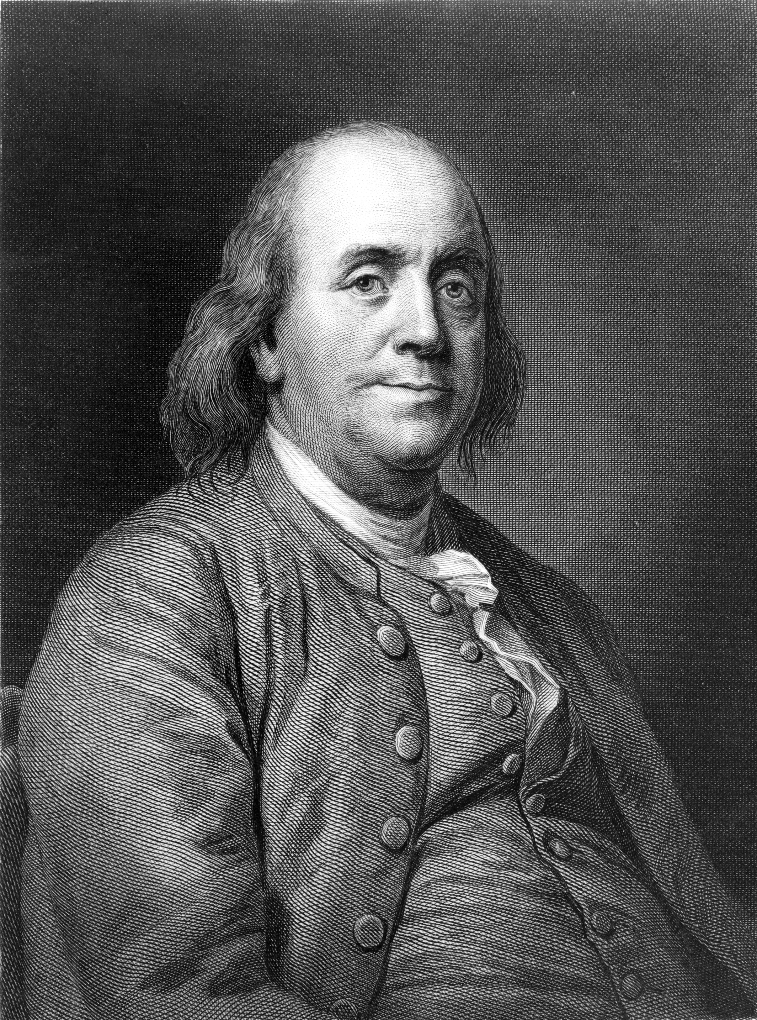
“Money never made a man happy yet, nor will it. The more a man has, the more he wants. Instead of filling a vacuum, it makes one.”
Benjamin Franklin

Slide 21
Swinging Away
EARNING
Education, Careers and Income

Slide 22

The average U.S. salary = $35,000
Assuming 30 years of work (many work longer), lifetime earnings =
$1,050,000
Living paycheck to paycheck means that you will spend more than you earn

Slide 23

“It’s not how much money you make. It’s how much money you keep!”

Slide 24
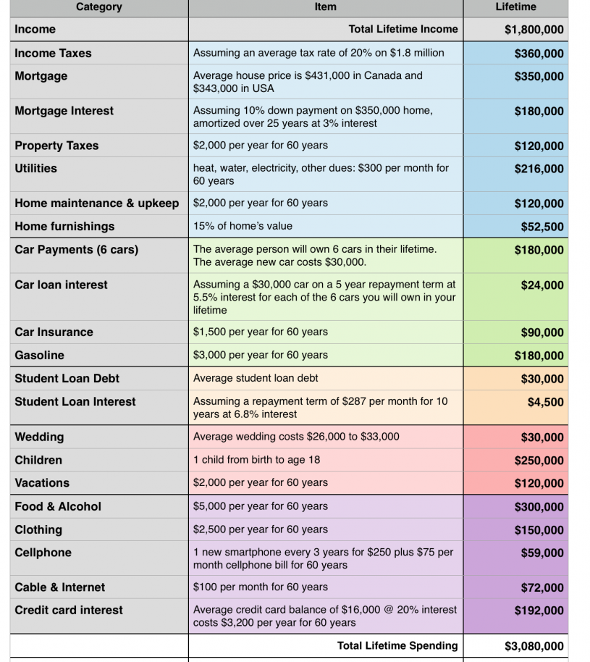
Lifetime Income vs. Lifetime Expenses

Slide 25

Human capital is the skills, knowledge, and training that people posses, measured by their economic value.

Slide 26
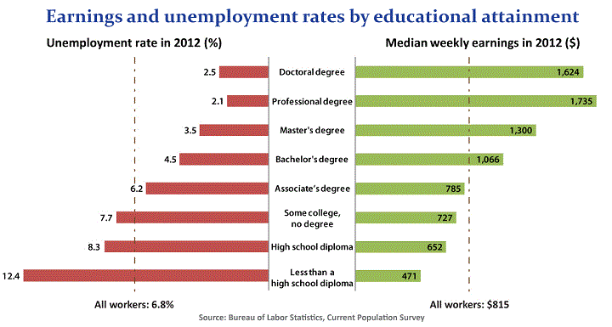

Slide 27


PLANNING FOR POSTSECONDARY EDUCATION
Complete interest inventory.
Identify career goals.
Research postsecondary options.
Submit your Free Application for Federal Student Aid (FAFSA).
Research strategies to finance your education.

Slide 28

PAYING CASH FOR COLLEGE
Scholarships
Grants
Work-study programs
College savings plans
Student loans

Slide 29
PAYING CASH FOR COLLEGE
70% of college seniors graduated with debt from student loans.
The average debt load was $37,172.
The average monthly payment was $351.

Slide 30

PAYING CASH FOR COLLEGE
STUDENT LOAN RULE OF THUMB:
Don’t borrow more money for all the years of your postsecondary education than you expect to make during your first year of employment.
Check out the lowest 10%
in salary in your field at:

Slide 31
The Surprising Secrets of America’s Wealthy
7. They choose the right occupation.
20% of affluent households in America are retirees.
Of the remaining 80%, more than two-thirds are headed by self-employed owners of businesses.
Self-employed people are 4 times more likely to be millionaires than those who work for others.

Slide 32

“In order to make millions you must affect millions!”

Slide 33
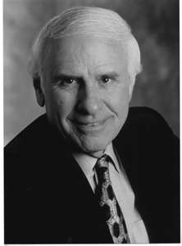
“An investment in knowledge pays the best interest.”
Benjamin Franklin
“Formal education will make you a living; self-education will make you a fortune.”
Jim Rohn

Slide 34






Slide 35
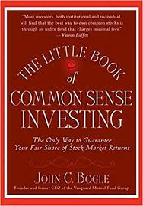
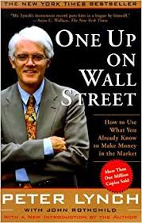
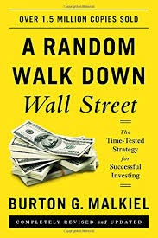

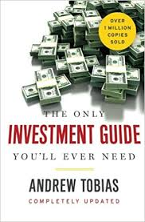
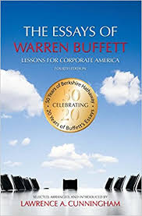

Slide 36
On Base
GIVING 10%
EARNING
Planning and Money Management

Slide 37

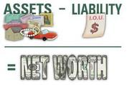
Determining Net Worth
asset- something that you own
liability- something that you owe
net worth- a measure of wealth that takes “what you own” minus “what you owe”

Slide 38



Your Budget
A plan to manage your money and your time
  Understand where your money goes
  Live within your means and meet your goals
  Find uses for your money that will increase wealth
  Take control of your money and time

Slide 39
How much is your time really worth? (Your real hourly wage)
 | Hours/Week | $/Week | $/Hour
Basic Job (before adjustments) | 40 | 680 | 17
Adjustments
Commuting | 7.5 | -100
Costuming | 1.5 | -23
Meals | 5 | -40
Decompression | 5 | -30
Escape Entertainment | 5 | -40
Vacation | 5 | -30
Job-related illness | 1 | -22
Time and money spent on maintain job (total adjustments) | 30 | -285
Job, with adjustments (actual total) | 70 | 420 | 6
Every dollar spent =
15 minutes of life energy (money)

Slide 40

Making Your Budget
Determine Your Income
  Wages

Slide 41
Your Paycheck
gross pay- money earned before taxes and other deductions are taken from your paycheck
  Federal Insurance Corporation Act (FICA)- provides money (social security) and health care (Medicare) for the retired, elderly, and disabled
net pay- the money left as your paycheck after taxes and other deductions

Slide 42
Making Your Budget
Determine Your Income (net pay)
  Wages
  Gifts
  Scholarships, grants, student aid
  Passive income

Slide 43
Making Your Budget
Track Your Expenses
  Food
  Bills/Utilities
  Transportation
  Debt
  Activities
Create a Plan
  Implement the plan
  Review the plan
  Adjust the plan

Slide 44



Anti-Budget… But Emergency Fund & Tracking Expenses
The Money Book for the Young, Fabulous & Broke
  Screw Budgets, but…….save up, the emergency fund, cutting expenses are highly encouraged
Your Money or Your Life
  Budgets, Like Diets, Don’t Work, but…….
  (Step 2B) Keep track of every cent that comes into or goes out of your life.
  (Step 3) Every month create a table of all income and all expenses within categories generated by your own unique spending pattern.
Budget Apps to Ease the Headache

Slide 45
The Surprising Secrets of America’s Wealthy
2. They allocate their time, energy, and money efficiently, in ways conducive to building wealth
Prodigious accumulators of wealth (PAWs) allocate nearly twice the number of hours per month to planning their financial investments as under accumulators of wealth (UAWs) do.

Slide 46

Just when I get ahead…..

Slide 47

Preparing for the Unexpected
Financial emergencies come in many forms:
Natural disasters
Illness or injury
Loss of a family member
Loss of a job
Debt
Higher education costs

Slide 48

An emergency fund is money set aside that can quickly be accessed for unexpected expenses

Slide 49

Your Emergency Plan Should Include:
Important Documents
Family emergency contacts
Personal items
Cash, debit cards, credit cards, checks
3 to 6 months of living expenses is the recommended amount for an emergency fund

Slide 50
Financial Preparedness Includes:
3-6 month emergency fund
A relationship with a traditional financial institution
3 to 6 months of living expenses is the recommended amount for an emergency fund

Slide 51


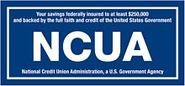
Types of Traditional Financial Institutions
Commercial Banks
For-profit business, making profits for shareholders
Insured by Federal Deposit Insurance Corporation (FDIC) for $250,000 on deposit accounts
Credit Unions
Non-profit organizations traditionally created for members of a common bond (e.g. teachers, military, etc.)
Insured by National Credit Union Administration (NCUA) for $250,000 on deposit accounts

Slide 52

Federal Reserve Bank
The central bank of the United States
Supervises and regulates financial institutions
Responsible for U.S. monetary policy

Slide 53
Types of Deposit Accounts
Checking Account
Most common form of deposit
Designed for frequent transactions
May earn interest
Over-draft protection (ODP)
Savings Account
Often used for emergency fund and other short-term savings goals
Minimum balance requirements

Slide 54
Types of Deposit Accounts
Money Market Account
Savings + Checking
Generally offers higher rates of returns
Higher minimum balance requirements
Limited number of transactions per month
Certificate of Deposit (CD)
Often used for intermediate-range goals of 3-5 years
Deposit locked in for a specific amount of time and interest rate
Penalties for early withdrawals

Slide 55

Choosing a Bank
Locations
Online Banking
Mobile Banking
Account Options
Meeting Needs

Slide 56
Giving 10%
GIVING 10%
EARNING
Planning and Money Management

Slide 57
The Spirit of Giving
“a strange truth, a reason for which I do not know…”
Find a reason greater than reality: the power of spirit
“Infinite Intelligence”
“believe that there is one intelligent substance from which all things proceed”

Slide 58
The Fulfillment Curve

Slide 59
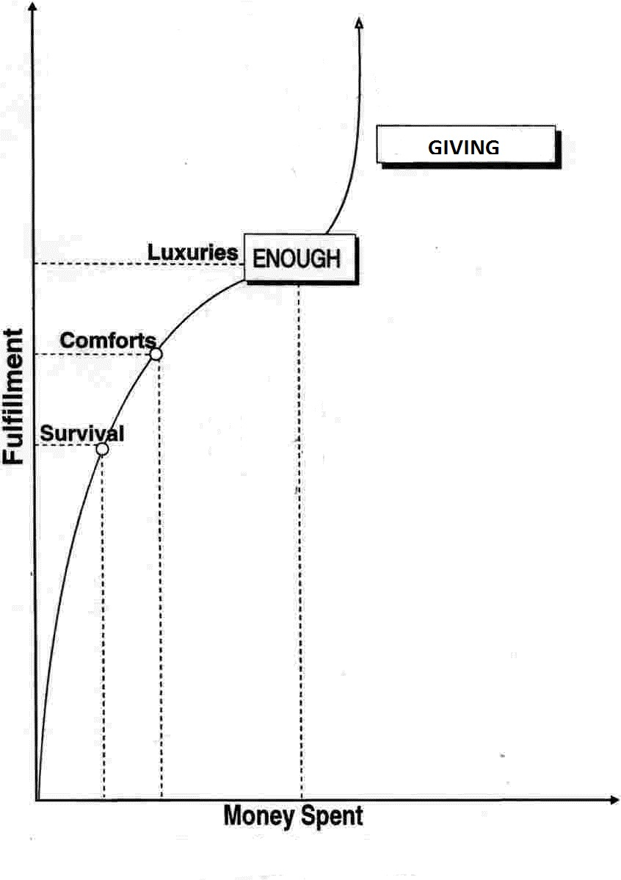
The Fulfillment Curve

Slide 60
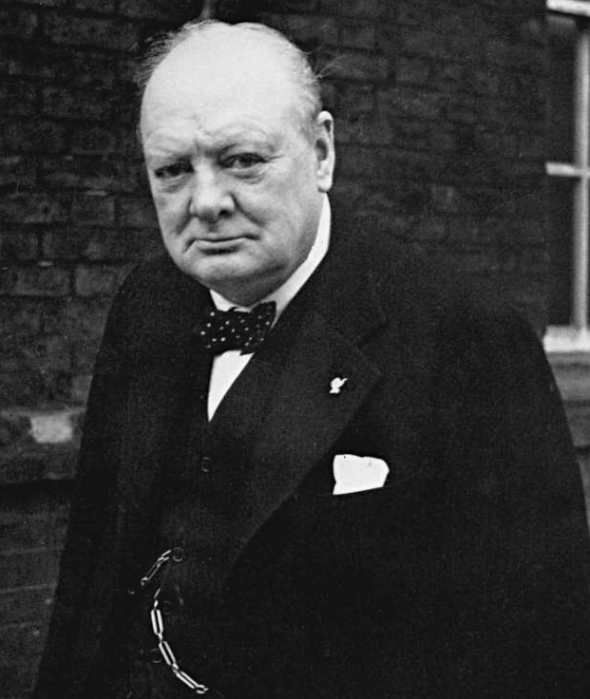
“We make a living by what we get, but we make a life by what we give.”
Winston Churchill

Slide 61


Tips For Giving To Charities
Do your research!
Check for tax-exemption status.
Give directly to the organization, not through solicitation.
Request privacy to avoid future solicitation.
Beware of names that sound like high-rated charities.

Slide 62




High Rated Charities

Slide 63

High Rated Charities

Slide 64
Stealing Second
SAVING 10%
GIVING 10%
EARNING
Credit and Debt
Risk Management

Slide 65
Financial Preparedness Includes:
3-6 month emergency fund
A relationship with a traditional financial institution
Access to credit
3 to 6 months of living expenses is the recommended amount for an emergency fund

Slide 66


Credit & Debt
credit- any arrangement made to receive something in exchange for a promise to pay back at a later date
or an assessment of your ability to handle your financial obligations
debt- something that is owed or is due

Slide 67

U.S. Household and Credit Card Debt, 2013-2017
Year | Average credit card debt per household | Average credit card debt per indebted household | Average total debt per household | Average total debt per indebted household
2013 | $6,224.53 | $16,318.85 | $94,080.47 | $126,207.12
2014 | $6,360.11 | $15,875.61 | $102,335.89 | $135,730.60
2015 | $6,587.77 | $15,692.23 | $103,837.08 | $136,183.05
2016 | $6,940.53 | $15,809.85 | $99,953.11 | $129,640.87
Q3 2017 | $7,135.80 | $15,654.02 | $102,204.86 | $131,430.72
METHODOLOGY
The online survey was conducted Nov. 8-10, 2017, in the U.S. by Harris Poll on behalf of NerdWallet. The survey of 2,089 U.S. adults ages 18 and older included 1,201 who have ever been in credit card debt. This online survey is not based on a probability sample, and therefore no estimate of theoretical sampling error can be calculated. For complete survey methodology, including weighting variables and subgroup sample sizes, please contact cc-studies@nerdwallet.com.
NerdWallet’s analysis included the following data from:
Board of Governors of the Federal Reserve System. “2016 Survey of Consumer Finances.”
U.S. Bureau of Labor Statistics. “Consumer Price Index”, September 2017
Federal Reserve Bank of New York. “The Center for Microeconomic Data”, September 2017
Federal Reserve Bank of St. Louis. “Commercial Bank Interest Rate on Credit Card Plans, Accounts Assessed”, August 2017
The Henry J. Kaiser Family Foundation. “Data Note: Americans’ Challenges with Health Care Costs”, March 2017
Peterson-Kaiser Health System Tracker. “Health System Dashboard”, 2015
U.S. Census Bureau. “Families and Households”, December 2016

Slide 68
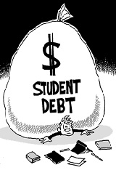
U.S. Household and Credit Card Debt, 2013-2017
StudentLoanHero.com report:
  The average 2016 graduate left school with $37,172 in total debt.
  The average monthly payment for borrowers, age 20-30, was $351.
A 2017 article in the Motley Fool says:
  The average loan amount on a new mortgage is $309,200.
  The average monthly payment is $1,494.
According to a WalletHub auto financing report:
  In 2016, the average new car auto loan financing cost was $28,667.30
  The average used car auto loan financed $17,241.59
USA Today reported the average monthly car payment last year is $499.
Edmunds reported that many Americans opt for longer terms now.

Slide 69

Types of Credit
Revolving
A line of credit that allows you to borrow as needed
Can be secured or unsecured
Flexible payments with a minimum payment required, usually calculated as a percentage of the balance
Examples: credit cards

Slide 70
A credit card is a revolving, high-interest, unsecured loan!

Slide 71
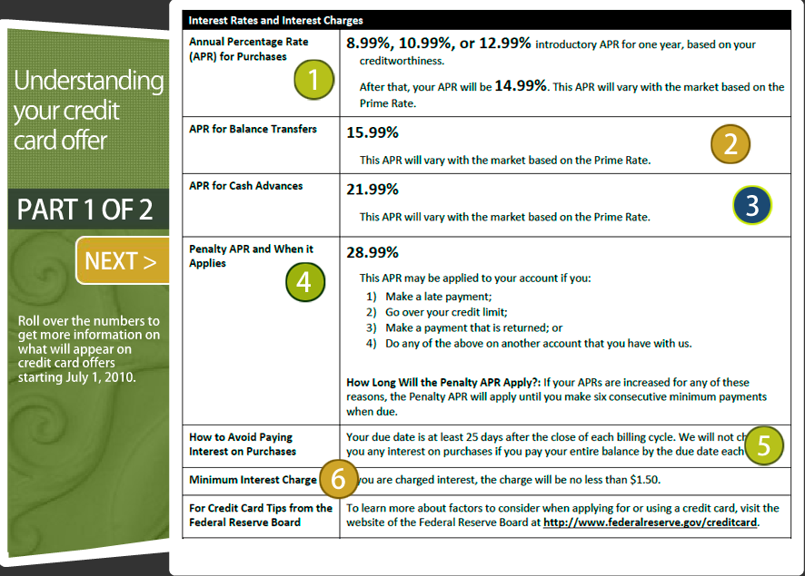

The Pitch

Slide 72
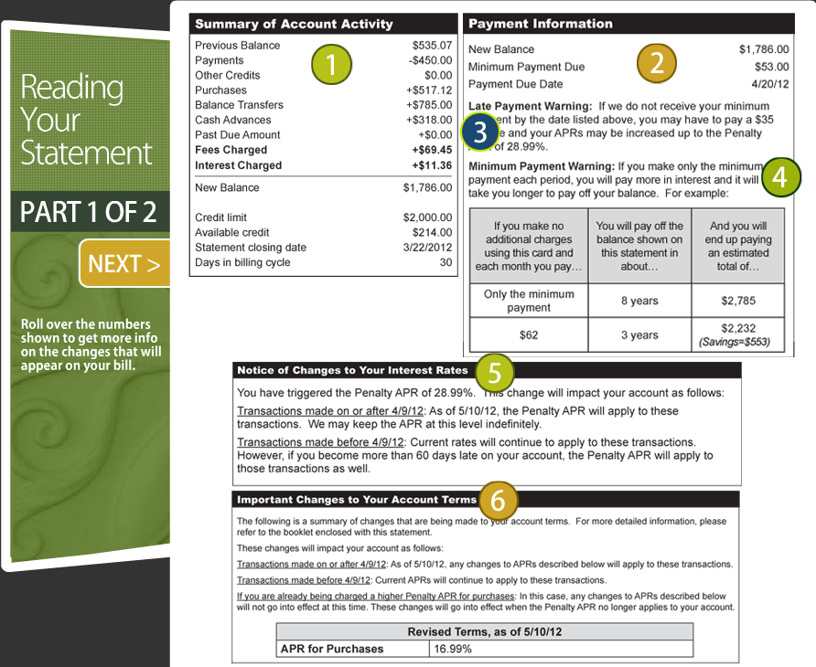
The Statement

Slide 73

The 6 Commandments of Credit Cards (with Coach E Rules)
Pay off your credit card regularly.
  Pay your balance IN FULL each month.
  Never be late with a payment.
  Forget cash advances.
Get all fees waived on your card.
Negotiate a lower APR.

Slide 74
The 6 Commandments of Credit Cards (with Coach E Rules)
Keep your cards for a long time and keep them active.
Get more credit (Warning! Do this only if you have no debt.)
  You may need one credit card; you do not need 12 cards!!
Use your rewards!

Slide 75

Types of Credit
Installment
Allows you to borrow a certain amount of money for a certain time period for a specific purpose
Can be secured or unsecured
Payments usually fixed
Examples: car loans, home loans, student loans

Slide 76

The Total Cost of Borrowing: Loan Basics
principal- the original amount of money borrowed or that is still owed
interest- the price you are paying for the use of someone else’s money, typically expressed as a rate (%)
APR- the interest rate on loans, credit, etc., that reflects the annual cost of borrowing money
loan term- the length of the loan

Slide 77
The Total Cost of Borrowing: Calculating Interest
Interest = principal x interest rate x time
I = PRT
You borrowed $1000 at 20% interest for 1 year
Convert the interest rate in decimal form
I = $1,000 x .20 x 1
I = $200 x 1
I = $200

Slide 78
The Total Cost of Borrowing: Calculating Monthly Payments
Monthly payment = (principal + interest) term
From previous slide:
Monthly payment = $1000+$200
12
= $1200
12
= $100 per month

Slide 79
The Total Cost of Borrowing: Opportunity Cost
The opportunity cost for borrowing money is giving up future purchases because of the interest and other fees associated with borrowing.

Slide 80
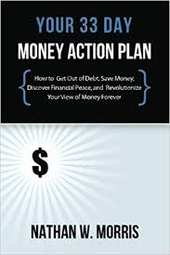
“Every time you borrow money, you’re robbing your future self.”
Nathan W. Morris

Slide 81

Lessons from Barney’s First Car
Do your homework.
Get your money first.
Shop around.
Be willing to walk away.
Look at both new and used cars.
Keep the purchase price in mind, NOT on the monthly payments.
Use the internet.

Slide 82
Lessons from Barney’s First Car
Don’t mention trading in your car, until the end.
Factor in the insurance costs.
Avoid impulse buying.
Don’t purchase any add-ons.
Don’t buy extended warranties.
Always test drive the car.
Visit a mechanic when buying a used car.
Buy a car you can afford.

Slide 83
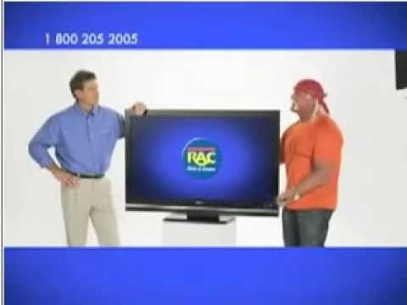




OPTIONS TO AVOID

Slide 84

Types of Credit
Service
Requires payment for a service that is in use to be paid in full on time
No interest, but service and late fees can be charged
Unsecured
Examples: utility bills, cell phone plan

Slide 85

Protecting Your Possessions
Home or Renters’
Auto
Health
Life
Disability

Slide 86
Protecting Your Possessions
policy- a written contract for insurance
premium- the price you pay for an insurance policy
deductible- the amount of money that you pay out of pocket for an insurance claim
co-pay- the amount of money that you pay for a covered health care service, usually at the time of the service

Slide 87
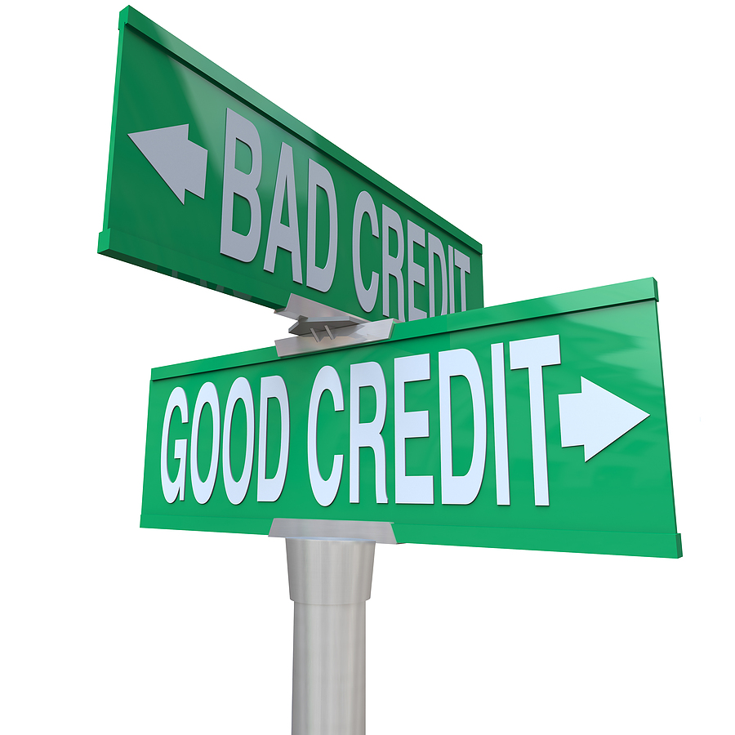
Credit Score Basics
credit history- your financial history that tells a lot about your ability to pay your bills on time
credit report- your financial transcript that shows lenders how you manage your financial responsibilities
credit score- your financial GPA that a lender calculates from entries in your credit report

Slide 88
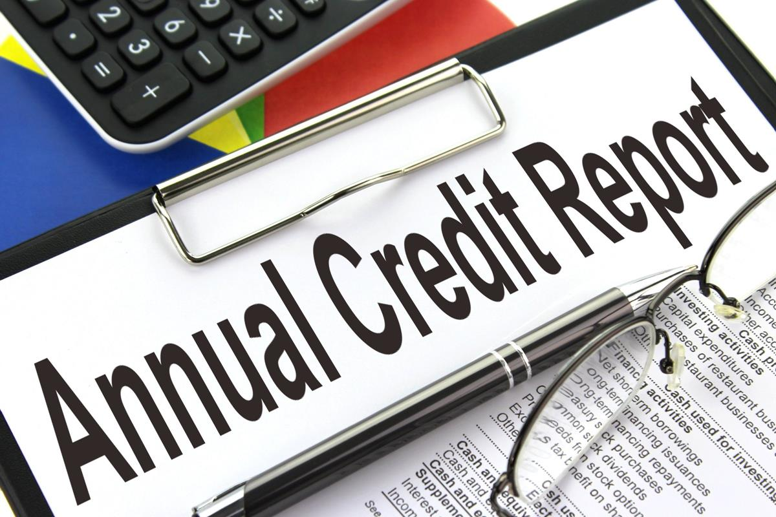



Maintaining a Good Credit History
Pay all of your bills on time.
Get a free credit report each year at www.annualcreditreport.com from each of the three major credit bureaus:

Slide 89
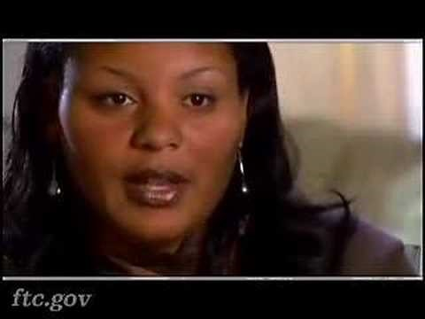

Identity Theft

Slide 90
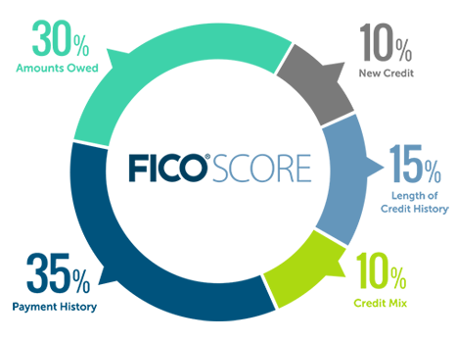
Payment History (35%)
The first thing any lender wants to know is whether you've paid past credit accounts on time. This is one of the most important factors in a FICO® Score.
Amounts Owed (30%)
Owing money on credit accounts doesn't necessarily mean you're a high-risk borrower with a low credit Score. However, when a high percentage of a person's available credit is been used, this can indicate that a person is overextended, and is more likely to make late or missed payments.

Slide 91
Length of Credit History (15%)
In general, a longer credit history will increase your FICO® Scores. However, even people who haven't been using credit long may have high FICO Scores, depending on how. the rest of the credit report looks
New Credit (10%)
Research shows that opening several credit accounts in a short period of time represents a greater risk - especially for people who don't have a long credit history.
Credit Mix (10%)
FICO Scores will consider your mix of credit cards, retail accounts, installment loans, finance company accounts and mortgage loans.

Slide 92
Is a Higher FICO Score Really Better?
If you are borrowing, YES!!!
Sample interest and payment for a $20,000 car loan paid over 60 months
Score | Interest Rate | Monthly Payment | Total Interest Paid | Difference
720-850 | 3.26% | $362 | $1,699
660-689 | 6.75% | $394 | $3,618 | $1919
500-589 | 16.70% | $494 | $9,632 | $7933

Slide 93

Truth in Lending Act (1968)
Covers disclosures about terms and costs.
Uniformity in how creditors calculate finance charges.
Introduced Annual Percentage rate (APR) calculations

Slide 94
Fair Credit Reporting Act (1970)
One free report from each of the three credit bureaus.
Any dispute must be investigated.
Inaccuracies must fixed and removed within 30 days.
Mandates how long negative items remain on your report (typically 7 years).

Slide 95
Fair Credit Billing Act (1974)
Safeguards against unfair billing practices, such as:
  You are charged for something you did not buy
  The amount you are charged is wrong
  You never received the items, received the wrong items, they weren’t delivered as agreed, or items were delivered damaged
  You don’t get credit for payments
  Statements are sent to the wrong address

Slide 96
Fair Debt Collection Practices Act (1977)
Protects consumers from threatening or harassing behavior from debt collectors, such as:
  Using abusive language
  Non-stop calling
  Calling after 9 pm or before 8 am local time
  Talking with people other than your spouse or attorney
  Misrepresenting themselves as police or attorneys
  Contact after written notices demanding that they stop contacting you

Slide 97
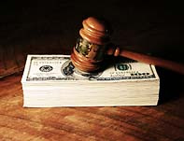
Bankruptcy
What will not be eliminated:
  Student loans
  Child support
  Taxes
Consequences:
  Stays on credit report for 10 years
  May be denied credit or given access to credit at inflated interest rates
  May be denied a job

Slide 98
Saving 10%
SAVING 10%
GIVING 10%
EARNING
Credit and Debt
Risk Management

Slide 99
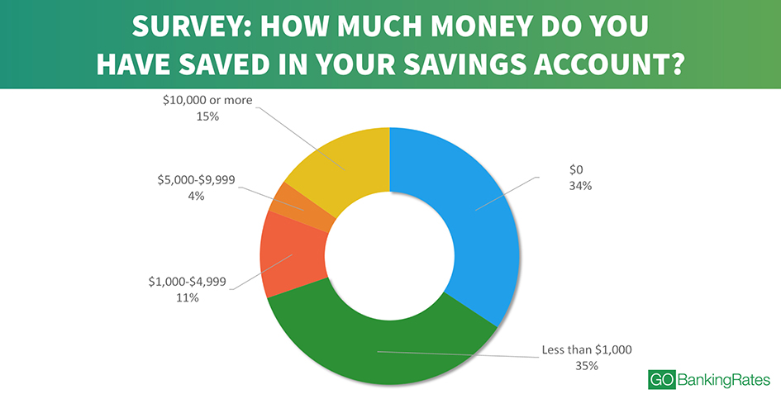


Slide 100
The First Cure for a Lean Purse:
Start thy purse to fattening
“Now I will tell a strange truth, the reason for which I know not. When I ceased to pay out more than nine-tenths of my earnings, I managed to get along just as well. I was not shorter than before. Also, ere long, did coins come to me more easily than before. Surely it is a law of the Gods that unto him who keepeth and spreadeth not a certain part of all his earnings, shall gold come more easily. Likewise, him whose purse is empty, does gold avoid.”

Slide 101
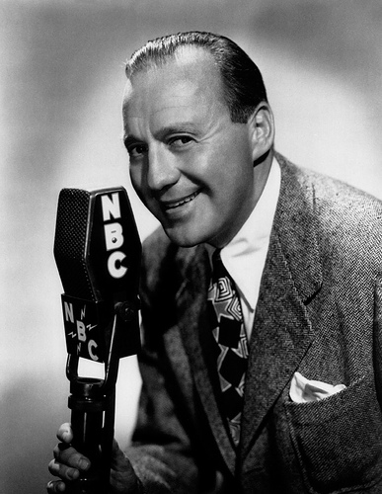
“Try to save something while your salary is small; it’s impossible to save after you begin to earn more.”
Jack Benny

Slide 102

Reasons for Saving
3-6 month emergency fund
Meet short-term goals
Keep funds secure while growing
Budget shortfalls

Slide 103
Common Savings Tools
Savings Account
Money Market Account
Certificate of Deposit (CD)
Savings Bond
Can cash out of full value of bond at maturity
Low risk, low return
Government-issued and backed

Slide 104

Check your bank and see if this option is available!

Slide 105
Rounding Third
SAVING 10%
GIVING 10%
INVESTING 10%
EARNING
Saving and Investing

Slide 106

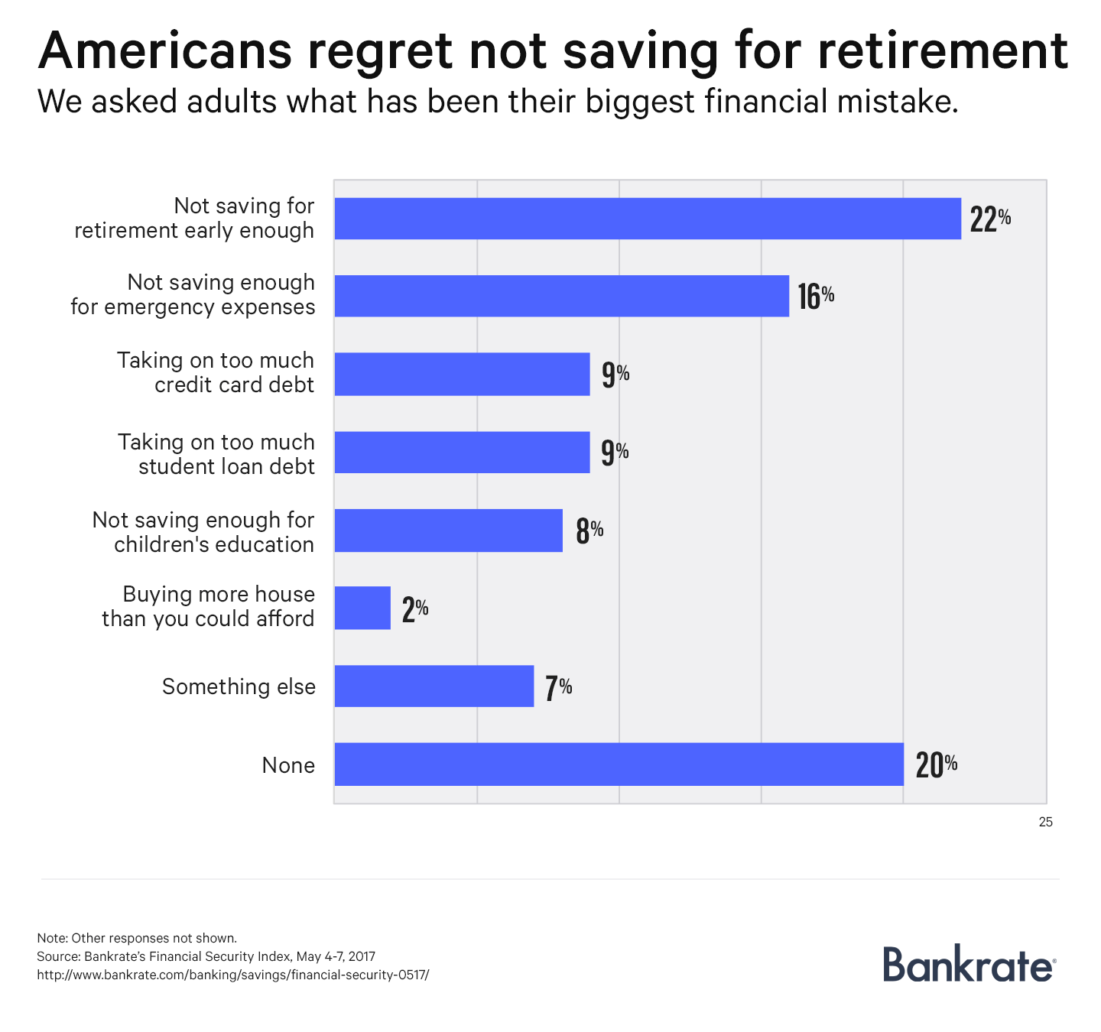


Time is Money

Slide 107

Retirement Options
401(k)- a salary-deferral program set up by a private employer or sponsor
Named for the section of the tax code in which they are described
tax-deferred- income taxes on this money and the interest it earns is postponed until you withdraw from the account
If your employer matches your contributions, TAKE IT!!

Slide 108
Retirement Options
ROTH IRA- an individual retirement account (IRA) designed to save for retirement on your own
No income taxes on this money whatsoever as contributions to account are all post-tax
Max contributions per year
Can withdraw contributions after 5 years penalty-free (not recommended)
Can withdraw money penalty-free at age 59½
The sooner, the better!

Slide 109
Investing 10%
SAVING 10%
GIVING 10%
INVESTING 10%
EARNING
Saving and Investing

Slide 110
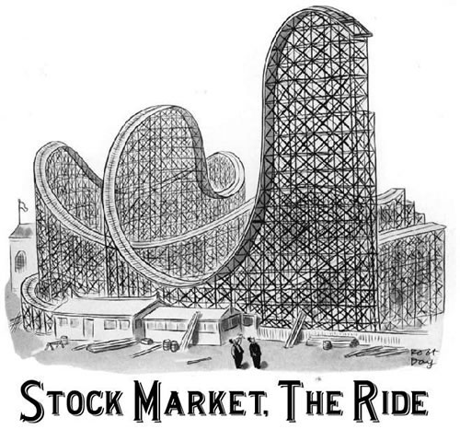
“If you have trouble imagining a 20% loss in the stock market, you shouldn’t be in stocks.”
-John Bogle
“Investing should be more like watching paint dry or watching grass grow. If you want excitement, take $800 and go to Vegas.”
-Paul Samuelson
“The Stock Market is designed to transfer money from the Active to the Patient.”
-Warren Buffett

Slide 111

Reasons for Investing
Plan for long-term goals like retirement
More risk for more return on an investment
Watch your money make money while you sleep (passive income)

Slide 112
Saving vs. Investing
Meet short-term goals
Keep funds secure while growing
Plan for long-term goals like retirement
More risk for more return on an investment
Watch your money make money while you sleep (passive income)

Slide 113

“How many millionaires do you know who have become wealthy by investing in savings accounts? I rest my case.”
-Robert G. Allen

Slide 114
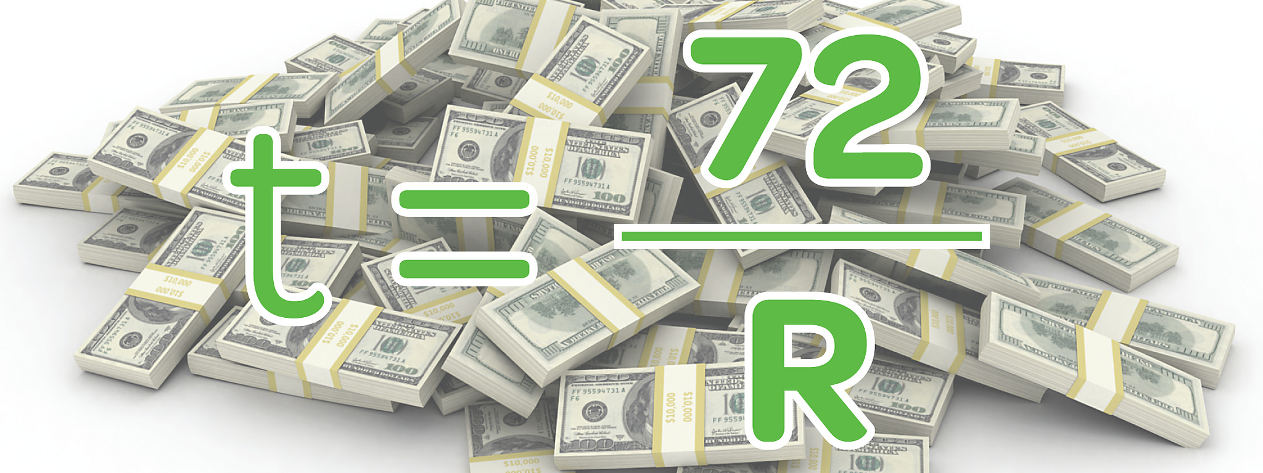
Rule of 72
Estimates the length of time (t) it takes for an investment to double with compound interest (R)

Slide 115
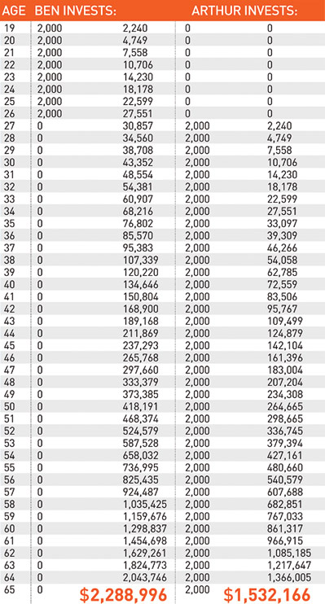
The Story of Ben and Arthur
Starting at age 19, Ben invested $2000 a year for 8 years. ($16,000 total)
Starting at age 27, Arthur invested $2000 a year for the next 39 years. ($78,000)
Arthur never caught Ben!
Starting early is the key!

Slide 116

Common Investing Tools
stocks- ownership shares of a company that may earn dividends
bonds- money that is lent to a corporation or the government that will return the full face value of the bond plus interest accrued

Slide 117
Common Investing Tools
mutual funds- actively-managed pools of money invested in many different stocks and bonds
  High fees and expenses
  index fund- a type of mutual fund that is designed to match or track the components of a market index like the S&P 500

Slide 118
“Don’t look for the needle in the haystack. Just buy the haystack.”
John Bogle

Slide 119
Common Investing Tools
mutual funds- pools of money invested in many different stocks and bonds
  High fees and expenses
  index fund- a type of mutual fund that is designed to match or track the components of a market index like the S&P 500
personal property- real estate, art, jewelry, antiques

Slide 120

Diversification
Allocating money across a wide variety of investments and savings tools to reduce the risk of loss
Don’t put all of your eggs in one basket!!

Slide 121
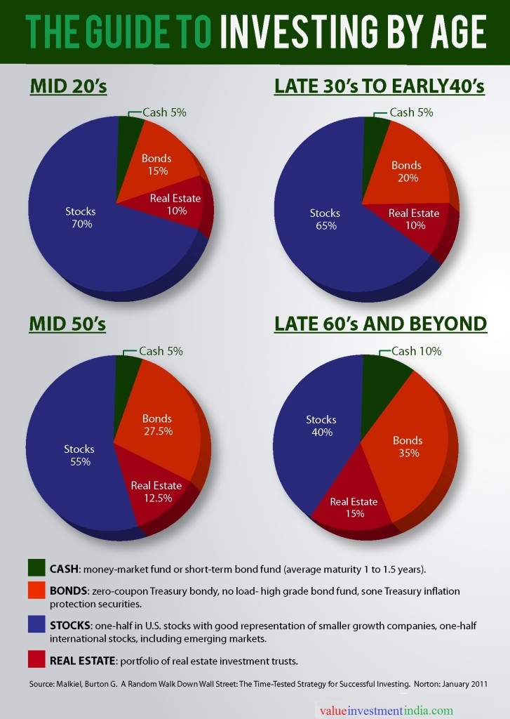
Model Portfolios
25% Growth and Income Funds
25% Growth Funds
25% International Funds
25% Aggressive Growth Funds
Stock Index Fund (% = 100-your age)
U.S. Treasury Bond Fund (% = your age)

Slide 122
For Future Players
SAVING 10%
GIVING 10%
INVESTING 10%
EARNING
Estate Planning
SPENDING

Slide 123

Leaving an Inheritance
Term-life insurance policy
Update beneficiaries on all accounts
Create a living will

Slide 124
Game Recap
SAVING 10%
GIVING 10%
INVESTING 10%
EARNING
Habits of Personal Finance
SPENDING

Slide 125
Game Recap
Tithe
Budget
3-6 month emergency fund
Pay bills IN FULL and ON TIME each month
Understand the true cost of borrowing
ROTH IRA or 401k (if company matches)
College savings plan
Index fund
Term-life insurance policy
Living will
Habits of Personal Finance

Slide 126
The Roster
“Living Paycheck to Paycheck Is a Way of Life for Majority of U.S. Workers, According to New CareerBuilder Survey.” Career Builder, press.careerbuilder.com/2017-08-24-Living-Paycheck-to-Paycheck-is-a-Way-of-Life-for-Majority-of-U-S-Workers-According-to-New-CareerBuilder-Survey.²
“Katrina’s Classroom: Teaching Money Skills for Life- Katrina Strikes.” Federal Reserve Bank of Atlanta, https://www.frbatlanta.org/education/katrinas-classroom/lesson1.aspx.
Eker, T. Harv. Secrets of the Millionaire Mind: Think Rich to Get Rich. Piatkus, 2008.
Ramsey, Dave. The Total Money Makeover: a Proven Plan for Financial Fitness. Nelson Books, an Imprint of Thomas Nelson, 2013.
https://www.forbes.com/forbes/welcome/?toURL=https://www.forbes.com/sites/robertberger/2014/04/30/top-100-money-quotes-of-all-time/&refURL=https://www.google.com/&referrer=https://www.google.com/
Stanley, Thomas J., and William D. Danko. The Millionaire next Door: the Surprising Secrets of America's Wealthy. Taylor Trade Publishing, 2016.
“Thom Hartman: Conversations with Great Minds- Tom Shadyac, P.1.” https://www.youtube.com/watch?v=uAsFipwYsr8.
Dominguez, Joseph R., and Vicki Robin. Your Money or Your Life: Transforming Your Relationship with Money and Achieving Financial Independence. Viking, 1992.
Bureau, US Census. “Income.” Census.gov, 9 Feb. 2016, www.census.gov/topics/income-poverty/income.html.
Kiyosaki, Robert T., and Sharon L. Lechter. Rich Dad, Poor Dad. What the Rich Teach Their Kids about Money-That the Poor and Middle Class Do Not! Warner, 2000
Casey, Bridget. “This Is Exactly How Much You Will Earn -- and Spend -- In Your Lifetime • Money After Graduation.” Money After Graduation, 10 Sept. 2016, www.moneyaftergraduation.com/2016/03/22/how-much-you-will-earn-and-spend-in-your-lifetime/.²⁶
“Unemployment Rates and Earnings by Educational Attainment, 2016.” Employment Projections, 24 Oct. 2017, www.bls.gov/emp/ep_chart_001.htm.²⁸
www.collegefortn.org
College Costs FAQ (College Board, bigfuture.collegeboard.org/pay-for-college/college-costs/college-costs-faqs) and the Project on Student Debt (projectonstudentdebt.org/state_by_state-data.php).³¹
A Look at the Shocking Student Loan Debt Statistics for 2018. 24 Jan. 2018, studentloanhero.com/student-loan-debt-statistics/.³¹
DeMarco, M. J. The Millionaire Fastlane: Crack the Code to Wealth and Live Rich for a Lifetime. Viperion Publishing Corporation, 2011.
Acknowledgements

Slide 127
The Roster
“Does Bill Gates Have A Lot Of Money?” Federal Reserve Bank of Atlanta, https://www.frbatlanta.org/-/media/documents/education/lessons-and-activities/bell-ringer/does-bill-gates-have-a-lot-of-money.pdf.
“Building Wealth- Budget to Save: The Balance Sheet, Real-Life Balance Sheets.” For Teachers - Building Wealth - Dallas Fed, www.dallasfed.org/~/media/microsites/cd/wealth/teachers.html.
“Forms, Instructions & Publications.” Forms & Instructions | Internal Revenue Service, www.irs.gov/forms-instructions.
“It's Your Paycheck! Curriculum Unit- Lesson 2: “W” is for Wages, W2 and W4.” Education Resources | St. Louis Fed, www.stlouisfed.org/education/its-your-paycheck-curriculum-unit.
Orman, Suze. The Money Book for the Young, Fabulous & Broke. Riverhead Books, 2007.
“It's Your Paycheck! Curriculum Unit- Lesson 4: Your Budget Plan.” Education Resources | St. Louis Fed, www.stlouisfed.org/education/its-your-paycheck-curriculum-unit.
www.richmondfed.org/publications/education/dollarsandsense.
Clason, George S. The Richest Man in Babylon. Signet/New American Library, 2008.
Hill, Napoleon, and Ben Holden-Crowther. Think and Grow Rich: MCMXXXVII. Ben Holden-Crowther, 2017.
Wattles, W. D. The Science of Getting Rich: Thrifty Books, 2009.
www.charitywatch.org
www.charitynavigator.org
Giorgianni, Anthony. “Best and Worst Charities for Your Donations.” Consumer Reports, 9 Dec. 2017, www.consumerreports.org/charities/best-charities-for-your-donations/.⁶⁴
“MLB Network Features Maverick’s Dream.” https://www.youtube.com/watch?v=gscGmgxjJCU.
El Issa, Erin. “NerdWallet's 2017 Household Debt Study.” NerdWallet, www.nerdwallet.com/blog/average-credit-card-debt-household/.
“Personal Finance Statistics: How Do You Compare? » Debt.com.” Debt.com, Debt.com, LLC, 22 Feb. 2018, www.debt.com/edu/personal-finance-statistics.⁷⁴
www.consumerfinance.gov/data-research/credit-card-data/. ⁷⁷ ⁷⁸
Sethi, Ramit. I Will Teach You to Be Rich: No Guilt, No Excuses, Just a 6-Week Programme That Works. Hodder & Stoughton, 2011.
“Building Wealth- Take Control of Debt: Term Loans- The Cost of Credit.” For Teachers - Building Wealth - Dallas Fed, www.dallasfed.org/~/media/microsites/cd/wealth/teachers.html.
Acknowledgements

Slide 128
The Roster
Reed, Phillip. “How to Use Edmunds True Cost to Own.” Edmunds, 30 Apr. 2009, www.edmunds.com/car-buying/true-cost-to-own-tco.html.
David BakkeDavid . “How to Buy a Car- 15 Essential Tips to Get the Best Deal.” Money Crashers, www.moneycrashers.com/how-to-buy-car-tips/. ⁸⁸ ⁸⁹
“Hulk Hogan Rent-A-Center Commerical with Troy Aikman.” https://www.youtube.com/watch?v=A1wkcJO1bWY.
“It's Your Paycheck! Curriculum Unit- Lesson 9: To Rent-to-Own or Not Rent-to-Own.” Education Resources | St. Louis Fed, www.stlouisfed.org/education/its-your-paycheck-curriculum-unit.
“It's Your Paycheck! Curriculum Unit- Lesson 8: So How Much Are You Really Paying for that Loan- Payday Fact Sheet.” Education Resources | St. Louis Fed, www.stlouisfed.org/education/its-your-paycheck-curriculum-unit.
“Building Wealth- Control Debt: Use Credit Wisely.” For Teachers - Building Wealth - Dallas Fed, www.dallasfed.org/~/media/microsites/cd/wealth/teachers.html.
www.annualcreditreport.com
“Deter. Detect. Defend. Avoid ID Theft. Federal Trade Commission.” https://www.youtube.com/watch?v=bC8pjXn-sWM. ⁹⁶
“How FICO Credit Score Is Calculated.” MyFICO, www.myfico.com/credit-education/whats-in-your-credit-score/. ⁹⁷ ⁹⁸
Sample loans savings calculator results from myfico.com, 5/20/2015. Compiled by Federal Reserve Bank of Atlanta. ⁹⁹
Consumer Protection. www.occ.treas.gov/topics/consumer-protection/index-consumer-protection.html. ¹⁰⁰ ¹⁰¹ ¹⁰² ¹⁰³
“It's Your Paycheck! Curriculum Unit- Lesson 7: Creditors’ Criteria and Borrower’s Rights and Responsibilities.” Education Resources | St. Louis Fed, www.stlouisfed.org/education/its-your-paycheck-curriculum-unit.
Bloom, Ester. “Here's How Many Americans Have Nothing at All in Savings.” CNBC, CNBC, 19 June 2017, www.cnbc.com/2017/06/19/heres-how-many-americans-have-nothing-at-all-in-savings.html#. ¹⁰⁶
Dixon, Amanda. “Americans' Biggest Financial Regret? Not Saving Enough.” Bankrate, Bankrate.com, 18 Dec. 2017, www.bankrate.com/banking/savings/financial-security-0517/. ¹¹⁴
Solutions, Ramsey. “How Teens Can Become Millionaires.” Daveramsey.com, Dave Ramsey, 12 July 2017, www.daveramsey.com/blog/how-teens-can-become-millionaires. ¹²²
Bogle, John C. The Little Book of Common Sense Investing the Only Way to Guarantee Your Fair Share of Stock Market Returns. John Wiley & Sons, Inc, 2017.
Acknowledgements

Slide 129
The Roster
Lynch, Peter, and John Rothchild. One up on Wall Street: How to Use What You Already Know to Make Money in the Market. Easton Press, 2003.
Malkiel, Burton G. A Random Walk down Wall Street the Time-Tested Strategy for Successful Investing. W.W. Norton & Company, 2016.
Tobias, Andrew P. The Only Investment Guide You'll Ever Need. Mariner Books/Houghton Mifflin Harcourt, 2010.
Buffett, Warren, and Lawrence A. Cunningham. The Essays of Warren Buffett: Lessons for Corporate America. Carolina Academic Press, 2015.
Shin, Laura. “Your Financial Checklist For Every Stage of Life.” Forbes, Forbes Magazine, 31 July 2014, www.forbes.com/sites/laurashin/2014/04/30/your-financial-checklist-for-every-stage-of-life/.
Photos courtesy of Microsoft Online Pictures by unknown author, licensed under CC BY-SA unless otherwise noted in PowerPoint presentation.
Book photos courtesy of amazon.com unless otherwise noted in PowerPoint presentation.
True Wealth © 2018
Acknowledgements

